Slide 1

5
PRESENTATION ON INVOICE SYSTEM
PRESENTED BY:
Ashbin Rai (310882)
Pratik Man Shrestha(310901)
Sujal Baidhya (310917)

Slide 2
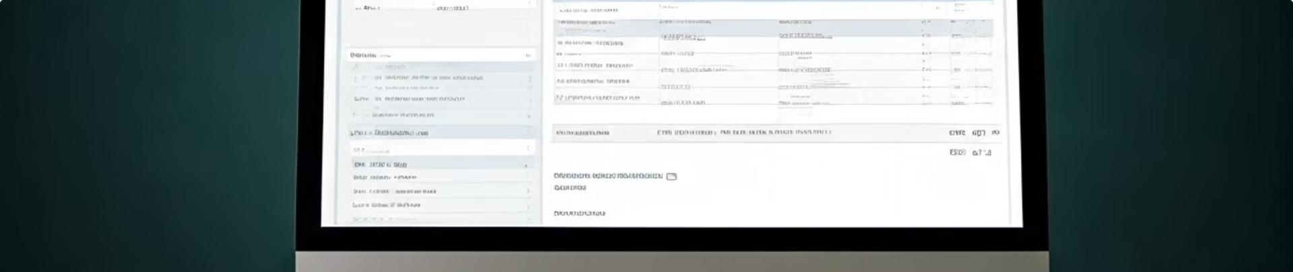
Introduction
1
Invoice Making System
2
Logging System
The Invoice Making System is based on the C programming language and handles the transaction records of various customers.
The program also includes a Logging System to track and record all activities.

Slide 3
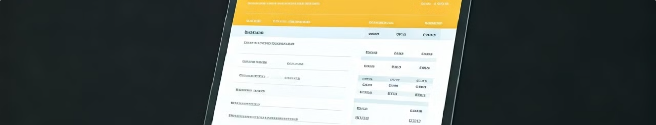
Features
1
Login and Sign up
2
Menu Management
The system includes Login and Sign up Features.
Users can Record and Modify Menu Details.
3
Security
4
Invoice Management
The system includes Password Encryption.
The system can Record and Store Customer's Invoices.

Slide 4
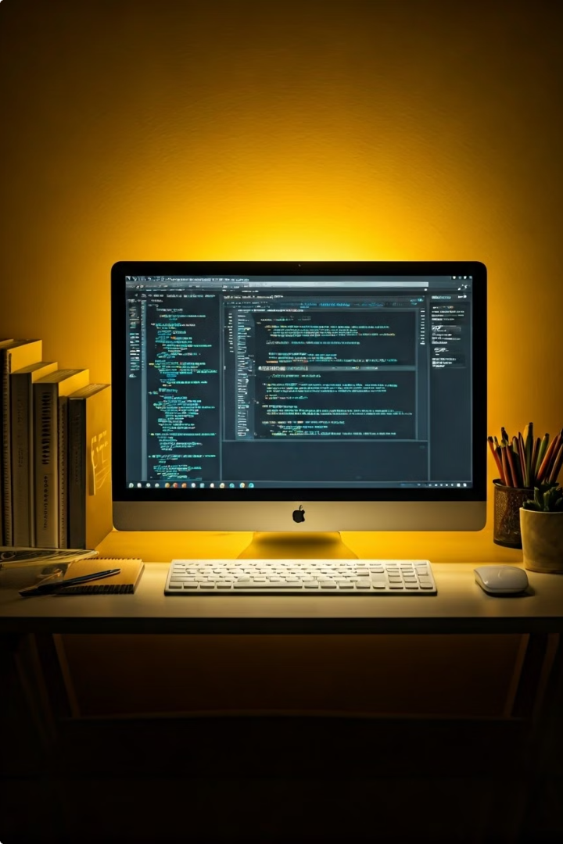
Concepts Used
1
C Programming Concepts
We used the following concepts and features of C programming to develop this program: Functions, Array, Structure, File Handling, Branching, Looping, and String.

Slide 5
Objectives
General Objectives
Specific Objectives
Helps the User to Store his/her transaction record in one particular location.
Provide detailed reports to help track revenue and monitor cash flow.
Ensure all bills and invoices are accurate, reducing human error in calculations and data entry.
Keep detailed customer profiles to improve service.
Handle billing disputes and adjustments efficiently.
Speed up the billing process by automating tasks such as invoice generation.

Slide 6





Advantages
Time Saving
Accuracy
Easy to Use
Less Manual Labor
Saves time by automating the creation and management of invoices.
Reduces mistakes in billing, ensuring invoices are always correct.
Easy To Use.
Less Manual Labor.
Backup
Backup Of The Invoices.

Slide 7
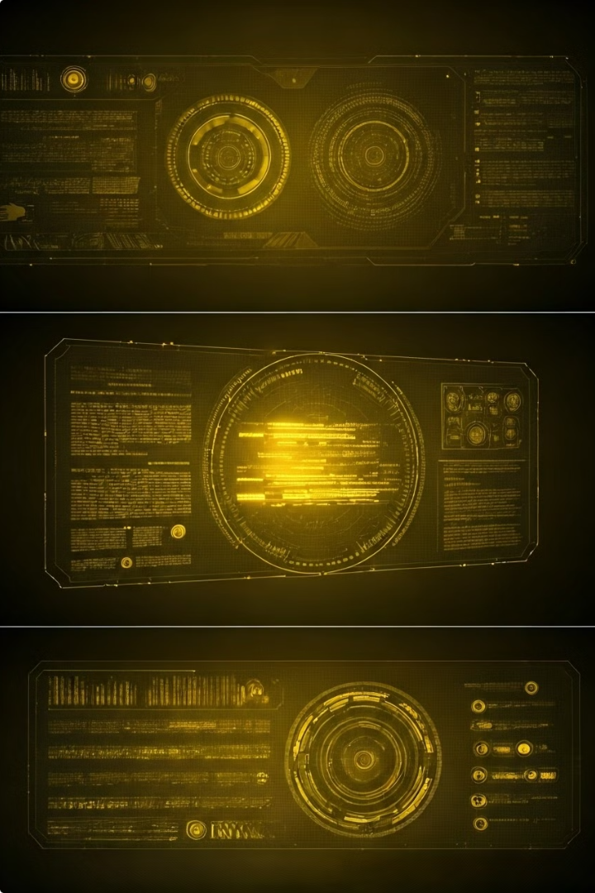
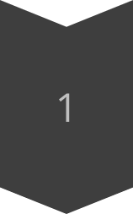


Future Prospects
Cloud Computing
Cloud Computing features can be implemented.
IoT Integration
IOT can be implemented on every aspect of a restaurant, not just the current billing system.
UI Improvements
UI improvements can be made to enhance the user experience.

Slide 8
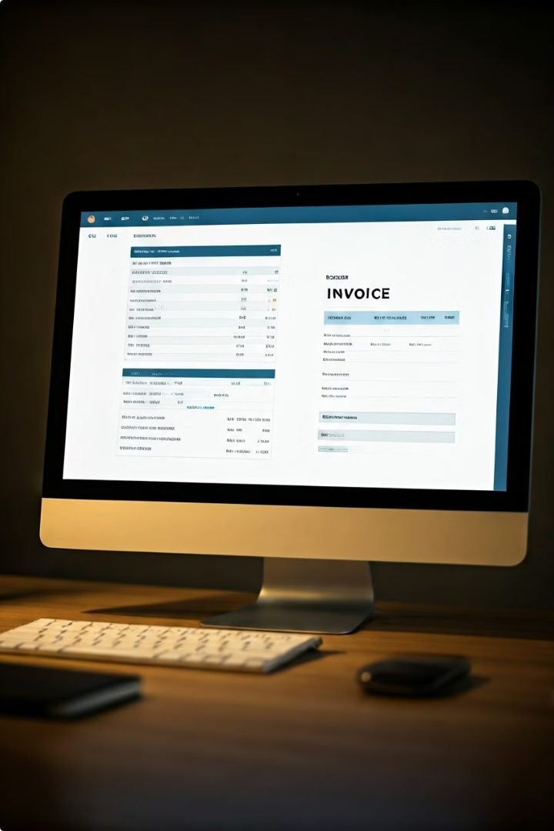
Demo
A live demonstration of the Invoice Making System will be provided to showcase its key features and functionality.

Slide 9
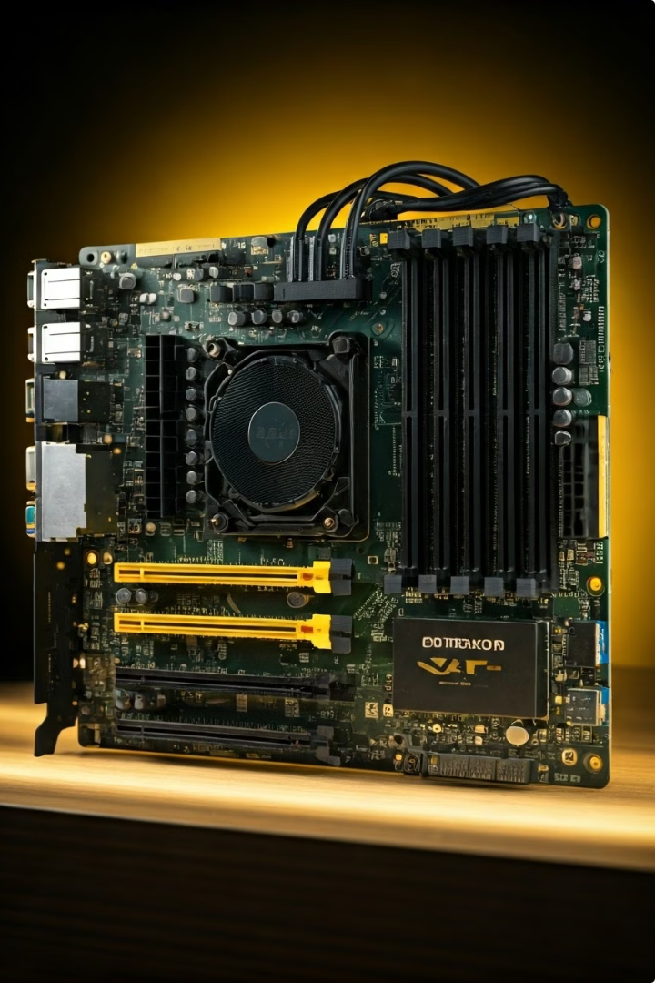
System Requirements
Operating System
Windows operating system (Windows 7 or higher).
RAM
8 MB or higher RAM.

Slide 10

Conclusion
Our billing system program in C successfully creates a simple and efficient way to handle billing, reducing mistakes and making the process faster. Key features include easy bill generation, a login system, and a user-friendly interface. We've tested the system thoroughly and added encryption to keep data safe. In the future, we plan to add more features, improve the design, make it scalable, and compatible with a variety of businesses. This project has taught us a lot and shown that our billing system can greatly improve how billing is done.

Slide 11
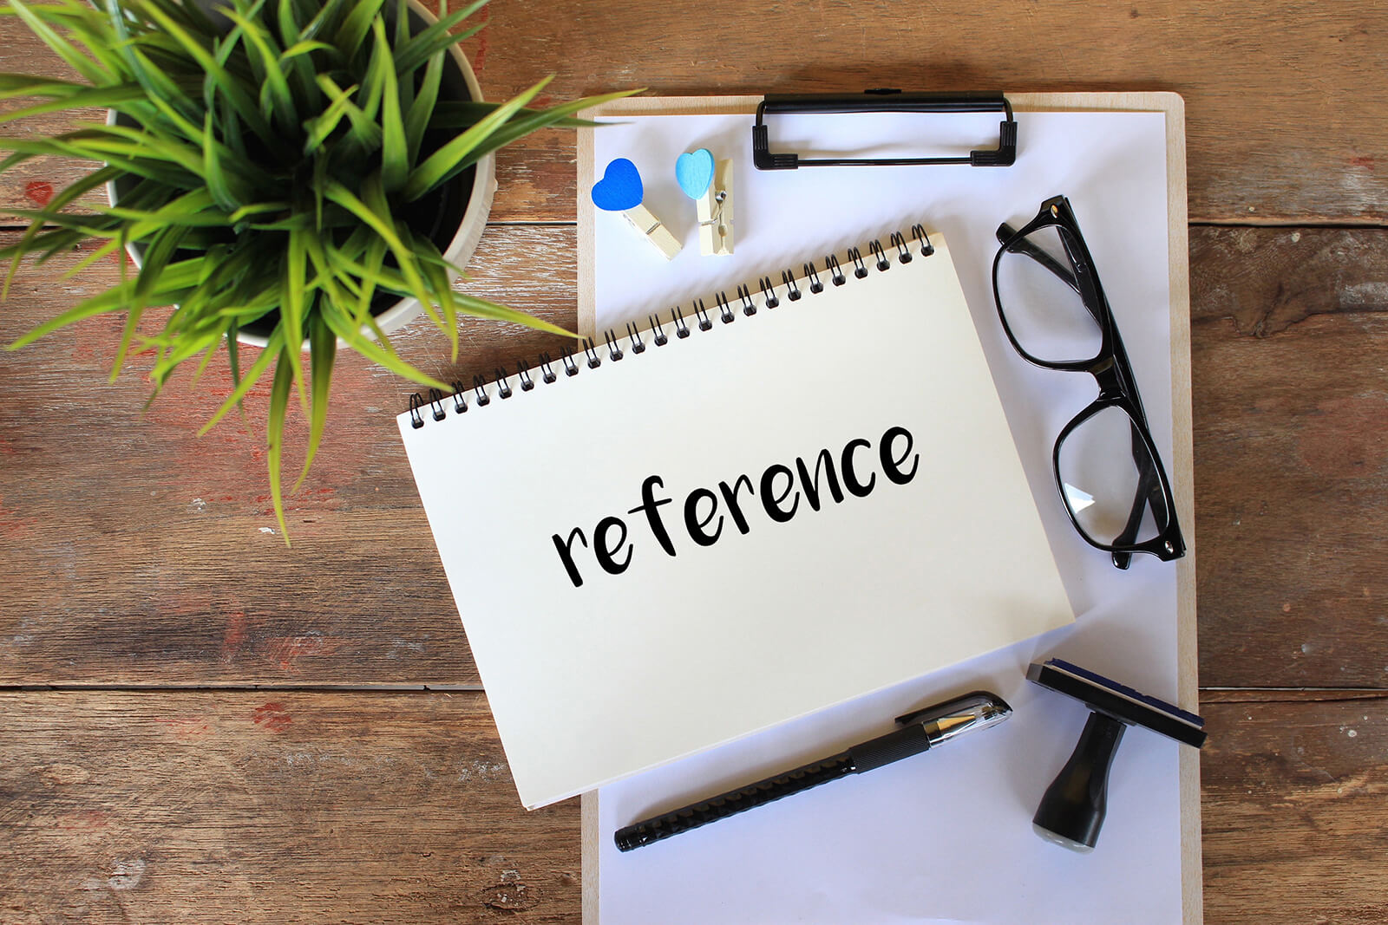
REFRENCES
Discussion Within Our Team.
Suggestion From Friends and Teacher.
https://youtu.be/_2msghvRn5M?si=amgMoqWRFoFKmjue
https://youtu.be/xtk14TcWaN4?si=DI0rUA31kBszCMpF

